Slide 1


ADW Power BI Project
Atharva Shirsalkar | Assistant Associate
Nagpur | 20th July 2023
Classification: Confidential

Slide 2
Agenda
Objectives
Approach
Requirement Analysis Questionnaire
Data Validation & Modelling
Power BI Report
All Testing
Issues faced & Lessons learnt

Slide 3
Objectives
01

Slide 4
Key Objectives
Adventure Works is a brand dedicated to quality and durability, with a focus on connecting people and the outdoors. We partner with retailers around the world to help get our innovative apparel and gear into the hands of millions of customers.
The Key Objective is to analyse Sales data for 3 years – 2014, 2015 and 2016 to help compare how the sales performance are as compared to last year sales. It provide further analysis by segregating the Sales by Product and Geography.
To provide an extended solution to help analyse Sales, Inventory Analysis holds equal value. How several Products are shipped and added to Inventory can help add such products at respected geographic location.

Slide 5
Approach
02

Slide 6
Approach
Power BI Report
06
05
Questionnaire
04
Testing
03
Objectives
02
Power BI Setup
01
Data Analysis

Slide 7
Requirement Analysis Questionnaire
03

Slide 8
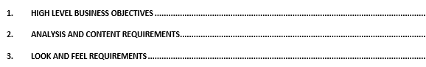
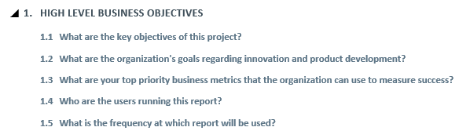
Requirement Questionnaire
Snaps of some questions:
Here is the link to complete Questionnaire document.

Slide 9
Data Validation & Modelling
04

Slide 10
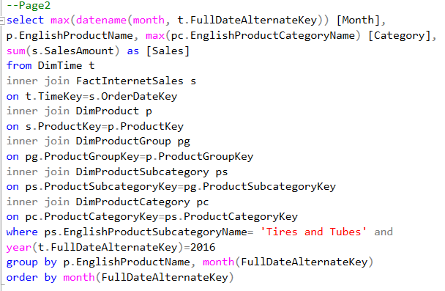
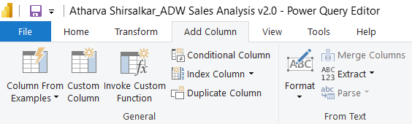
Data Validation & Transformation
MS SQL Server
Power Query Editor
Here is the link for SQL queries and data validation.

Slide 11
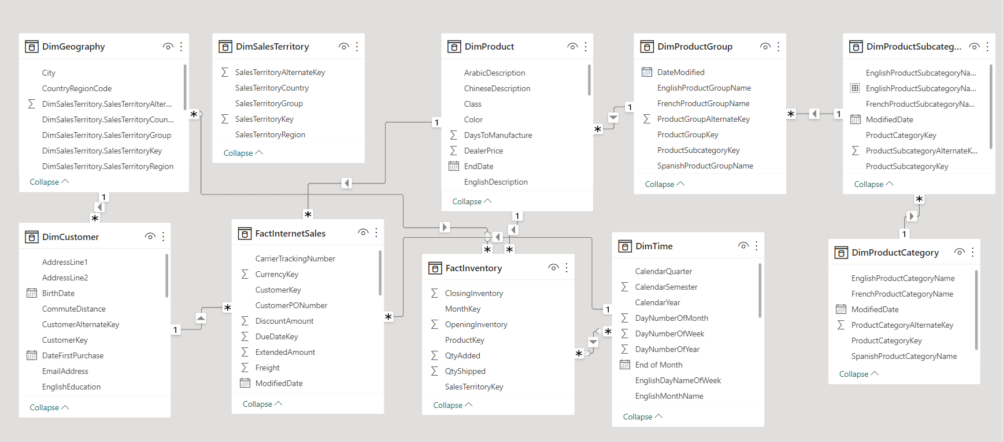
Data Model View

Slide 12
Objects & Report
05

Slide 13
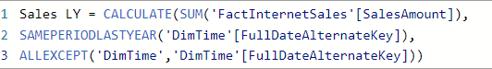
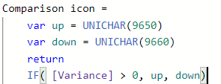
Measures

Slide 14
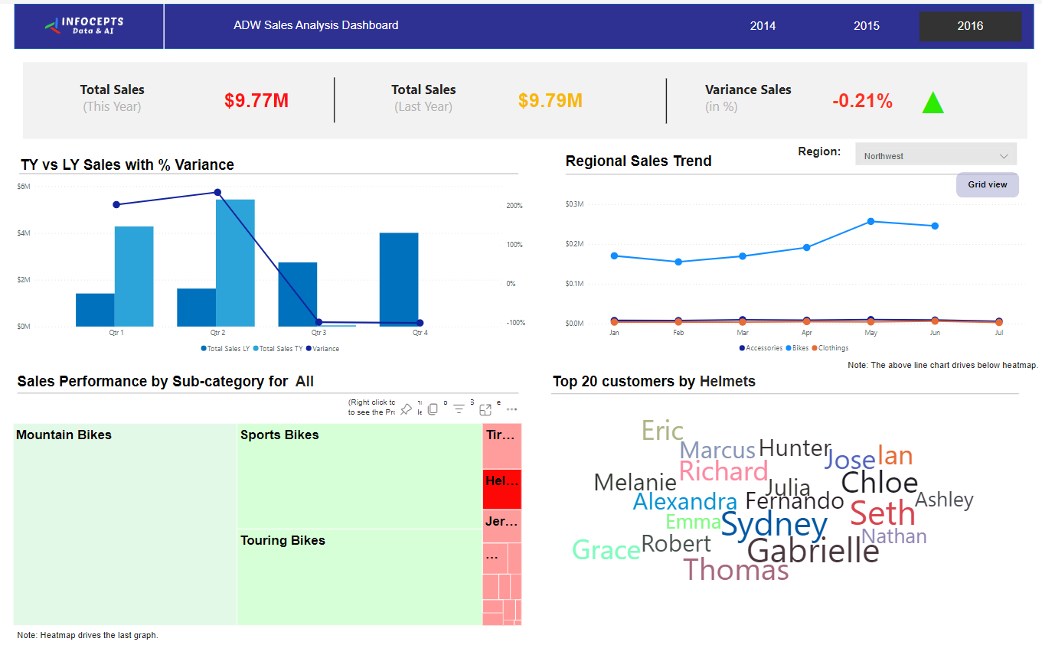
Report Creation
Sales Analysis:

Slide 15
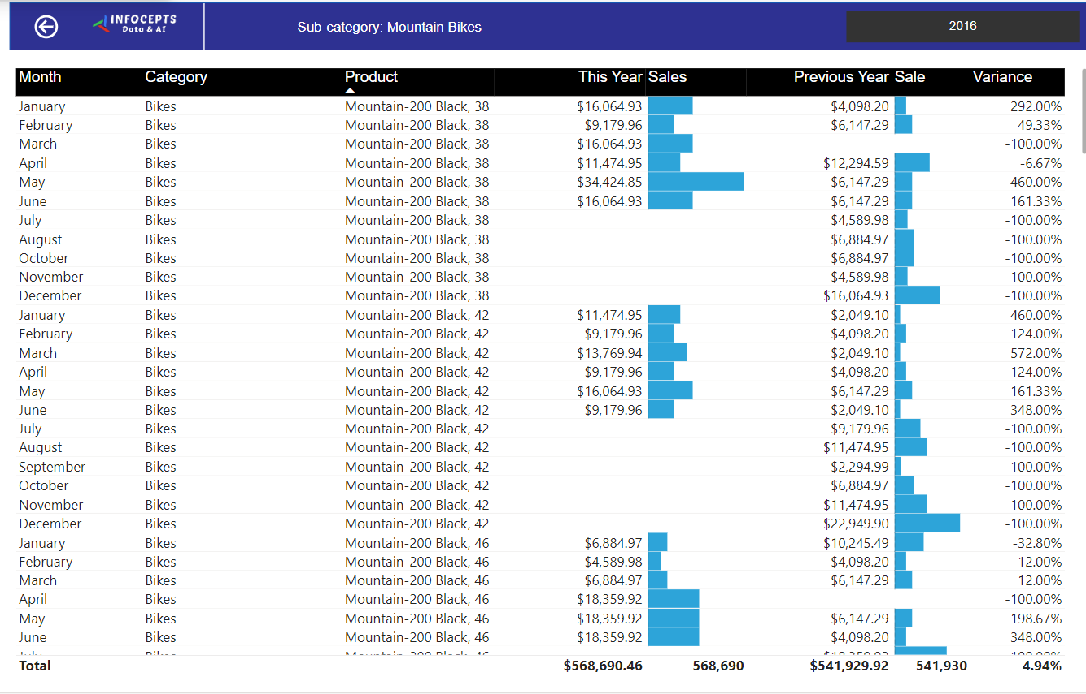
Report Creation
Details Page:

Slide 16
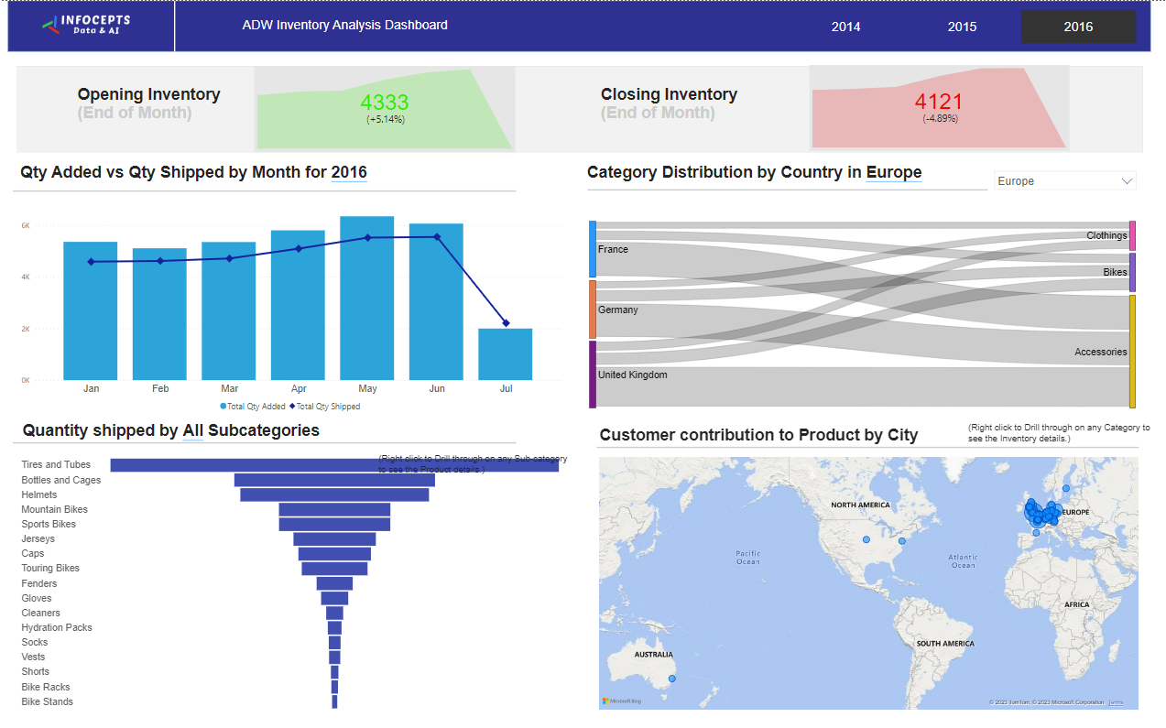
Report Creation
Inventory Analysis
Link for .pbix file.

Slide 17
Testing
06

Slide 18
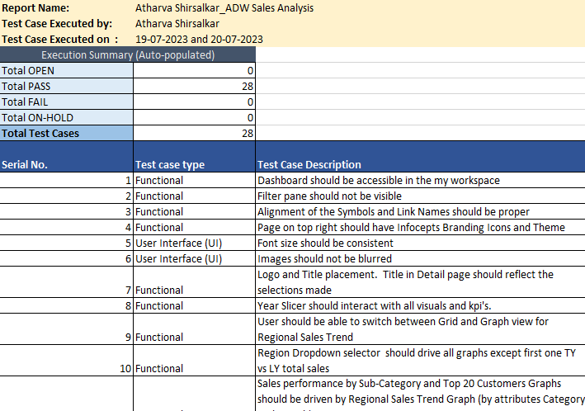
Testing
Functional
User Interface (UI)
Data
Here is the link for Test case document.

Slide 19
Issues & Fixes
07

Slide 20
Issues
Lessons
Automatic relationship made false relations.
ODBC error.
Wrong Joining of many-many relationship in a case.
Filter Flow was incorrect in 1 case
Inactive relationship config
Data Source settings (credentials error).
Turned off from Options
Re-config data source
Table merging
Data to Fact Filter flow
Correct active relationship
Had to change data source permissions
Link for Power BI Community.

Slide 21



Slide 22
ADW MSTR Project
Atharva Shirsalkar | Assistant Associate
Nagpur | 25th July 2023
Classification: Confidential

Slide 23
Agenda
Objectives
Approach
Requirement Analysis Questionnaire
MSTR Setup
Object Details
Schema & Objects
Datasets & Dashboards
Testing
Issues faced & Lessons learnt

Slide 24
Objectives
01

Slide 25
Key Objectives
Adventure Works is a brand dedicated to quality and durability, with a focus on connecting people and the outdoors. We partner with retailers around the world to help get our innovative apparel and gear into the hands of millions of customers.
The Key Objective is to analyse Sales data for 3 years – 2014, 2015 and 2016 to help compare how the sales performance are as compared to last year sales. It is divided into two major categories i.e., by Product and Customer. The main KPIs required are Sales, Profit and No. of Orders.

Slide 26
Approach
02

Slide 27
Approach
Objectives
Questionnaire
MSTR Setup
Report Details Doc
Issues & fixes
Testing
Datasets & Dashboards
Schema & Objects

Slide 28
Requirement Analysis Questionnaire
03

Slide 29
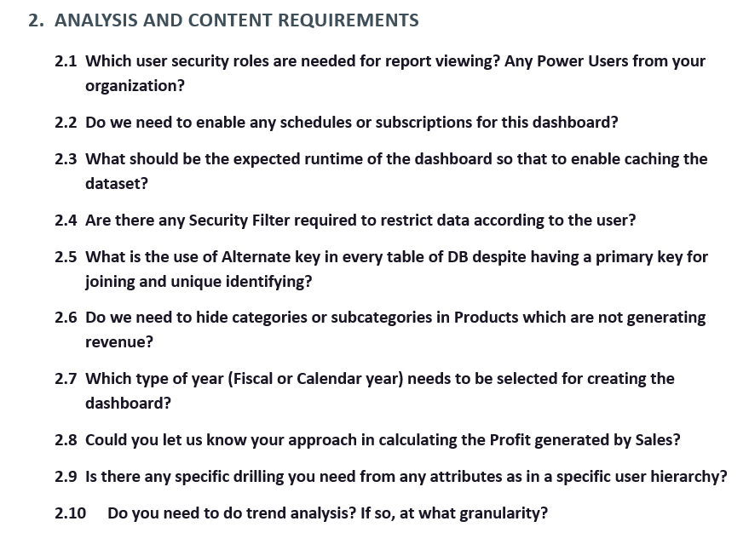
Questionnaire
Glance
Link for the doc.

Slide 30
MSTR Setup
04

Slide 31
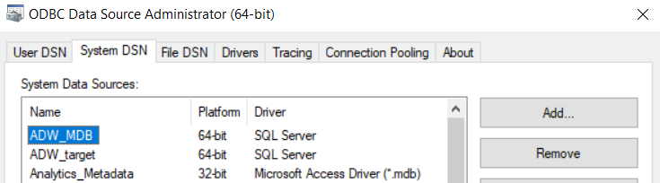
MSTR Setup
Data Source Name

Slide 32
Report Details
05

Slide 33
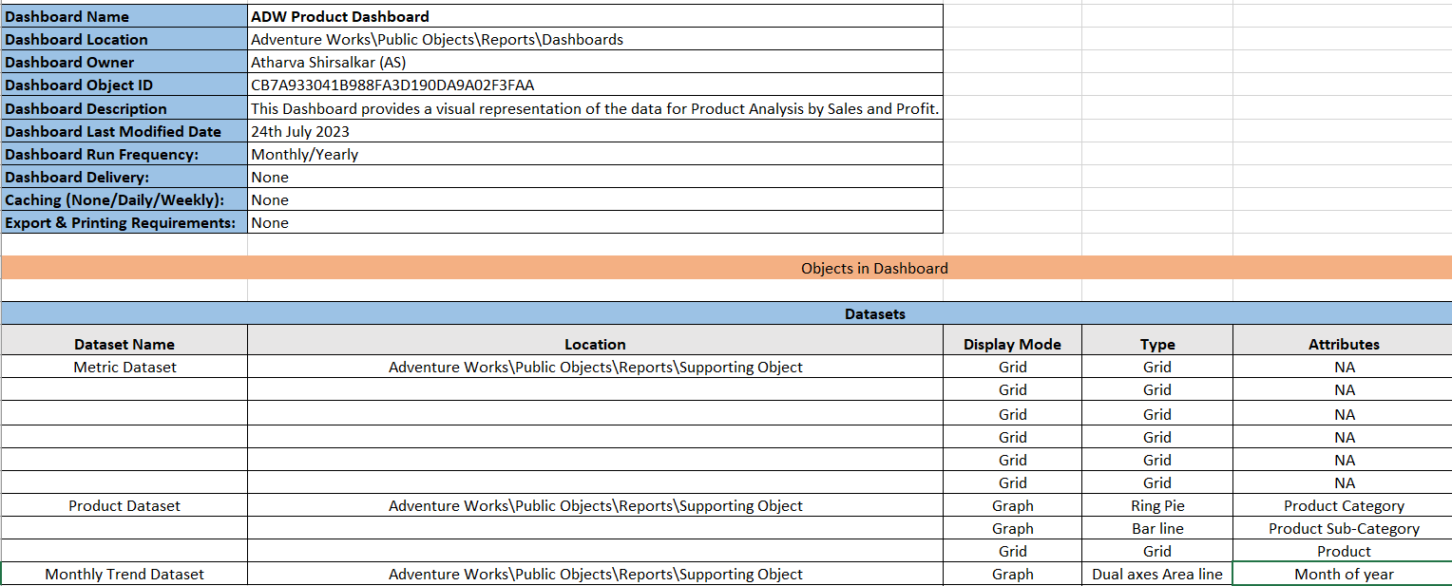
Report Details Document
Snapshot
Here is the link for the document.

Slide 34
Schema & Objects
06

Slide 35
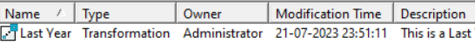
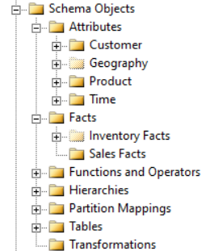
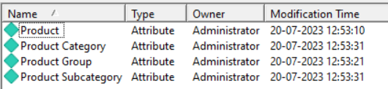
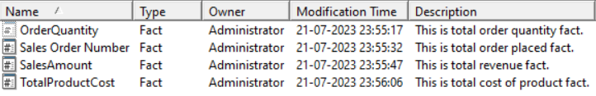
Schema Objects
Transformation, Attributes & Facts

Slide 36
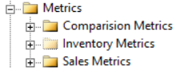
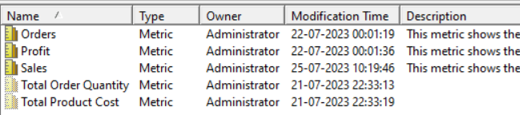
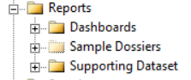
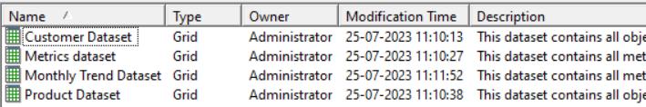
Application Objects
Metrics & Dataset

Slide 37
Datasets & Dashboards
07

Slide 38
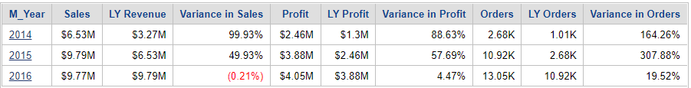
Datasets
Metrics dataset

Slide 39
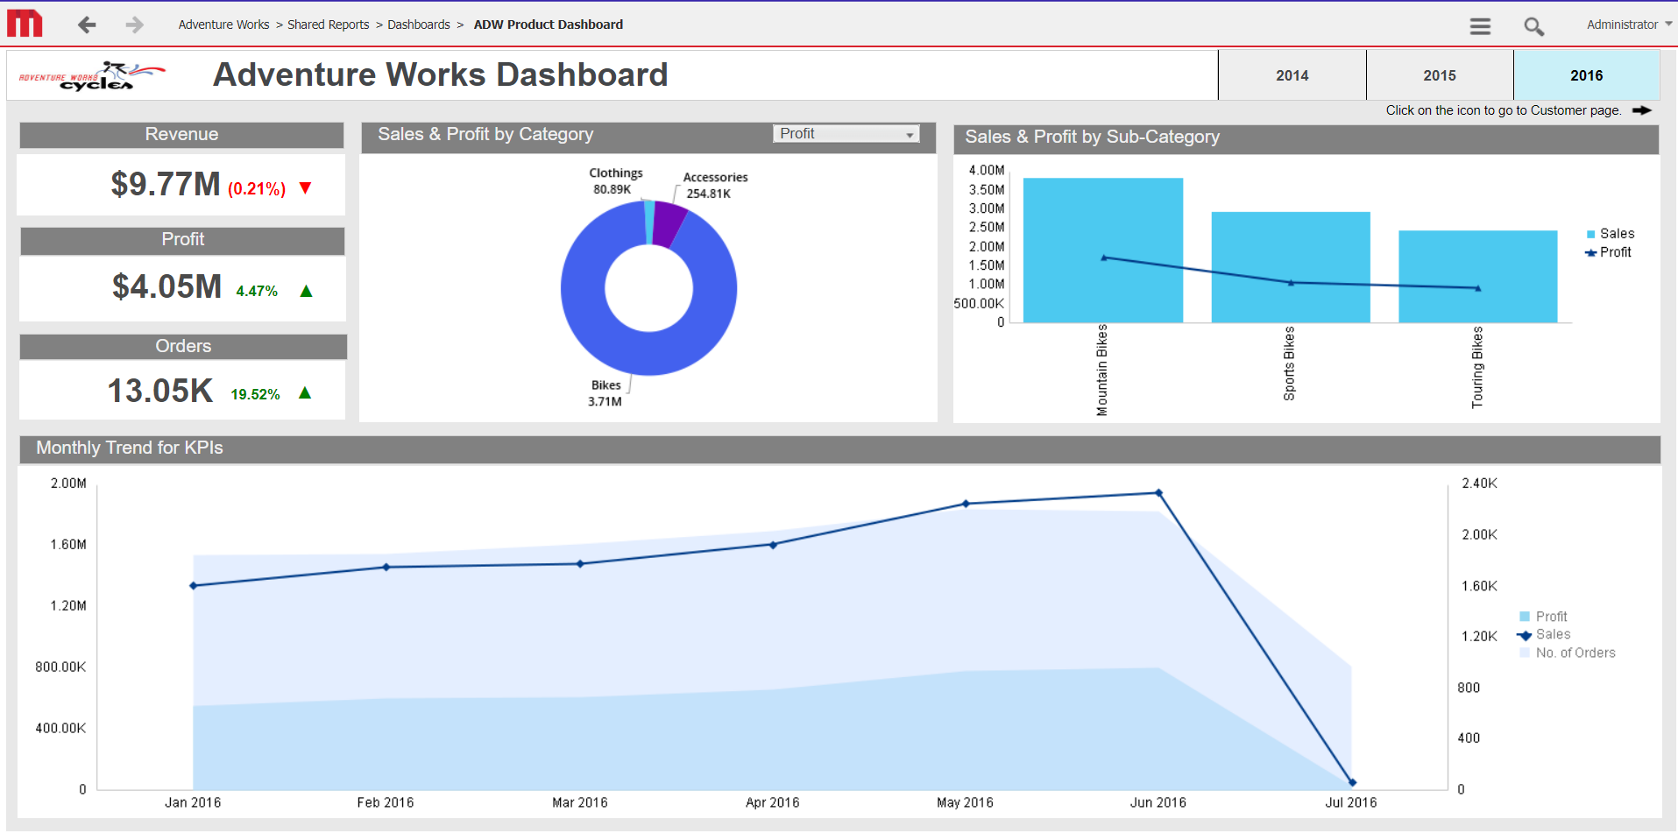
Product Dashboard

Slide 40
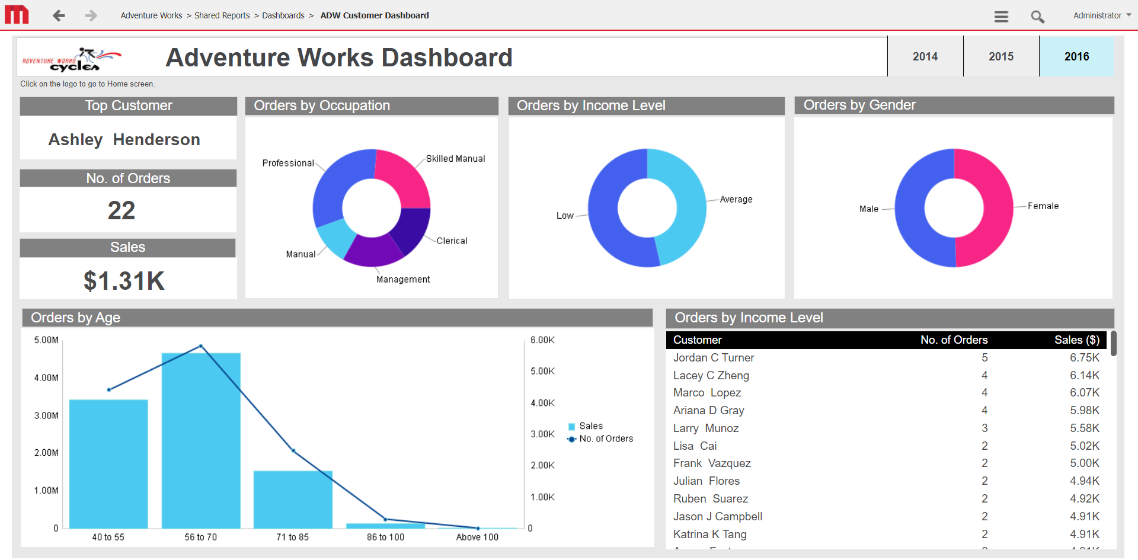
Customer dashboard
Link for Web

Slide 41
Testing
08

Slide 42
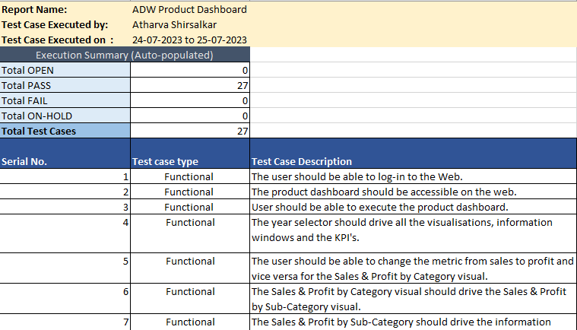
Testing
Functional
User Interface (UI)
Data
Here is the link for Test case document and link for SQL document.

Slide 43
Issues & Fixes
09

Slide 44
Issues
Lessons
Invalid syntax in pass through functions
Cartesian Join Governing ( Report execution failed )
Fact cross join attribute error & Fact not available at required level
Metric “Order” had its dynamic aggregation set as Default.
MSI Session logout
ApplySimple or case statements
Fact & Attribute joining at grain level
Corrected the Invalid Hierarchy of attribute & Correction child – parent relationship
Set the dynamic aggregation of the metric to Total.
Re-configuration of I-Server
Link for MSTR Community.

Slide 45
THANK YOU

